Slide 1
eCampus Portal
III Review (Coding& Execution /Results)
Presenters : 09211A0522,09211A0525,09211A0536,09211A0552
Guide :
Prof. Ch Madhu Babu
Date: 12-Apr-2013

Slide 2


Outline
Recap of II Review (Abstract, Use case diagram).
Project Implementation
PHP-The Programming Language
Well defined flow of Project Execution
Performance Issues/Results
Conclusion
References
Q & A

Slide 3

Recap of II Review
ABSTRACT
eCampus Portal is an online test portal where each college can register themselves and make use of these services.
There are three levels of users: Admin, Faculty and Students.
This Portal also provides a discussion forum for the students to interact with their faculty outside the classroom.
Any authenticated student/faculty can start a discussion on any topic.

Slide 4
Recap of II Review
USECASE DIAGRAM
(1)

Slide 5
Recap of II Review
USECASE DIAGRAM
(2)

Slide 6

Project Implementation

Slide 7

PHP The Programming Language
WHAT
I
S
PHP
PHP: Hypertext Processor
• Interpreted language
– Easy to get something done fast
– Problems when size and complexity grow
– Performance penalty (though addressed in later Zend engine)
• Language in evolution.PHP 5 adds exception handling. OOP is also an add-on since PHP4, PHP5 perfects it
– most OOP concepts and keywords are like in java: class, extends, interface, private, protected, etc.
– exceptions are like in Java (try/catch, etc)

Slide 8
PHP The Programming Language
PHP
I
N
HTML
The most often case where PHP is used -
• Escaping
– <?php …. ?>
– <? …. ?>
– <script language=”php” > ….</script>
– <% .... %>, <%=. … %> like ASP and JSP
• Like in JSP, escaping can be interrupted to write some HTML.
<?php
if ($expression) {
?>
<b>This is true.</b>
<?php } ?>

Slide 9
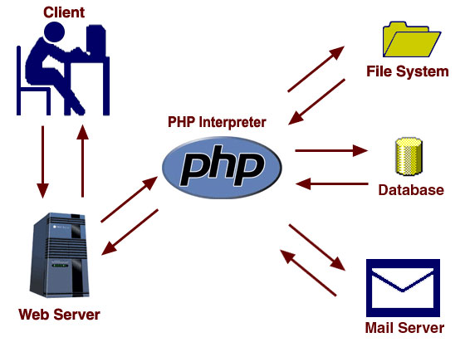
PHP The Programming Language
FEATURES
• HTTP authentication, cookies, file uploads
• Remote files (like java.net.URLConnection)
• Connections (like java.net.Socket)
• Persistent db connections
– Normally db connections are defined with engine specific functions as external resources. Each access would open its connection, that is expensive.

Slide 10
Project Execution (Well Defined Flow)

Slide 11
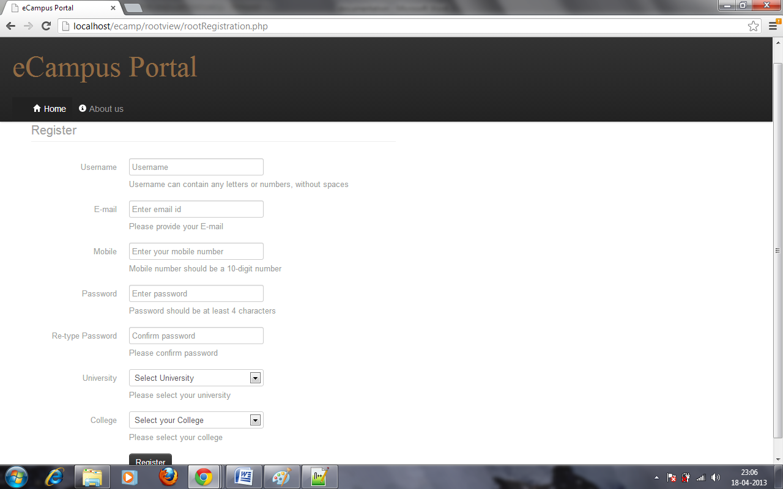
Admin Registration

Slide 12
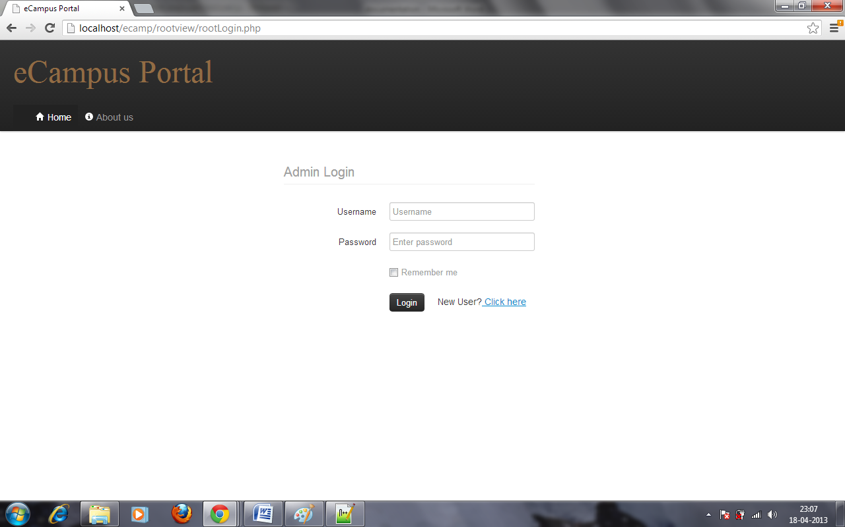
Admin Login

Slide 13
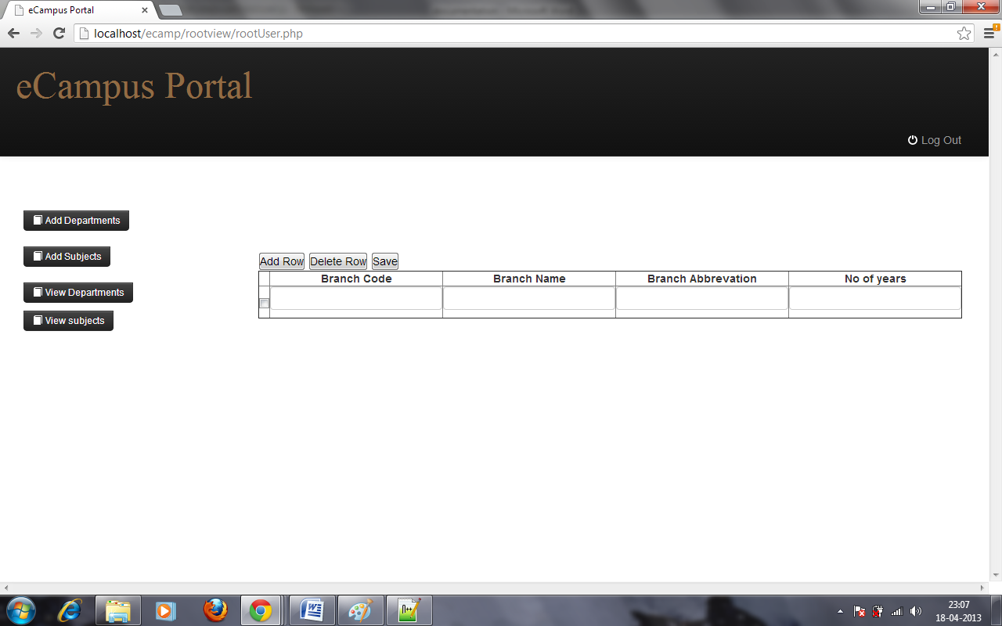
Adding Departments

Slide 14
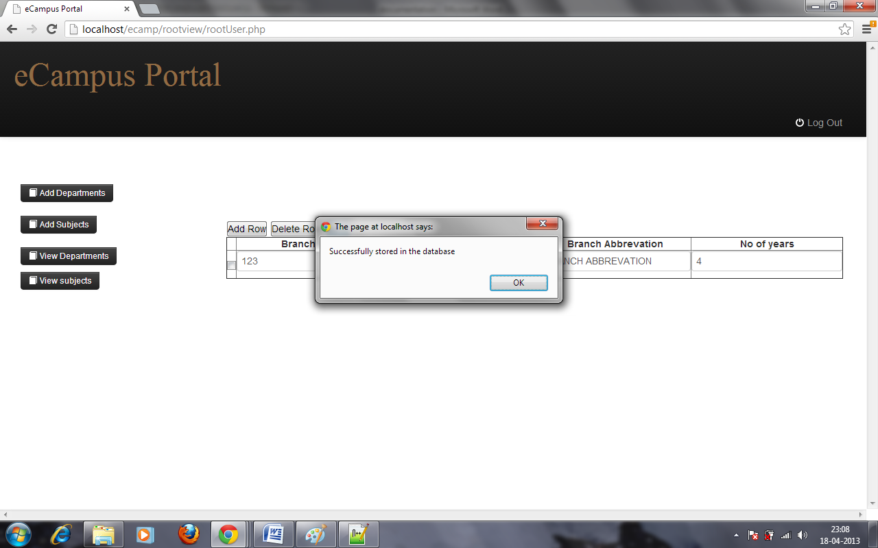
Departments stored successfully

Slide 15
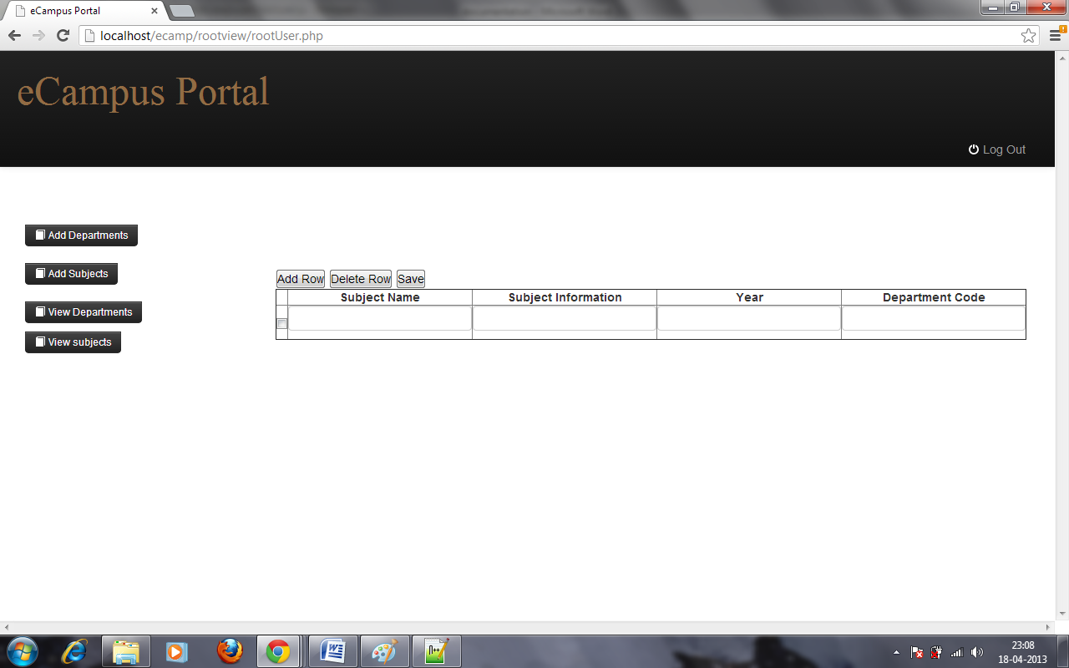
Adding Subjects

Slide 16
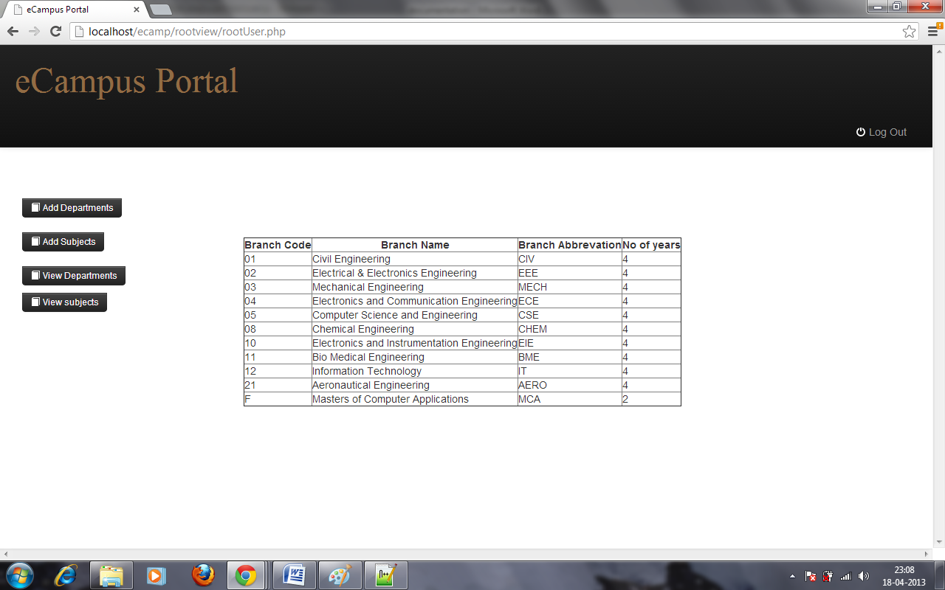
View Departments

Slide 17
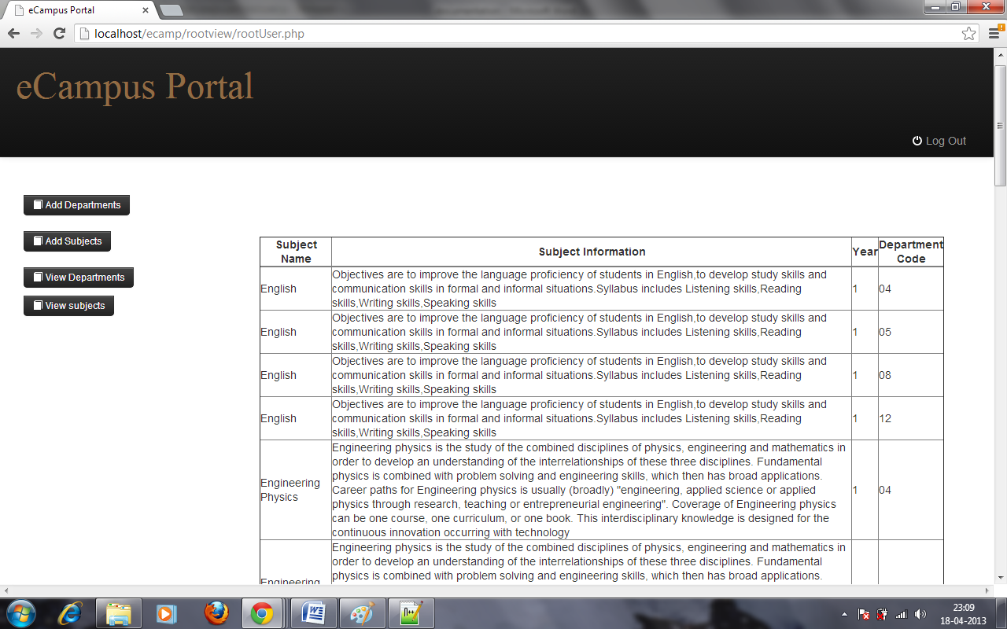
View Subjects

Slide 18
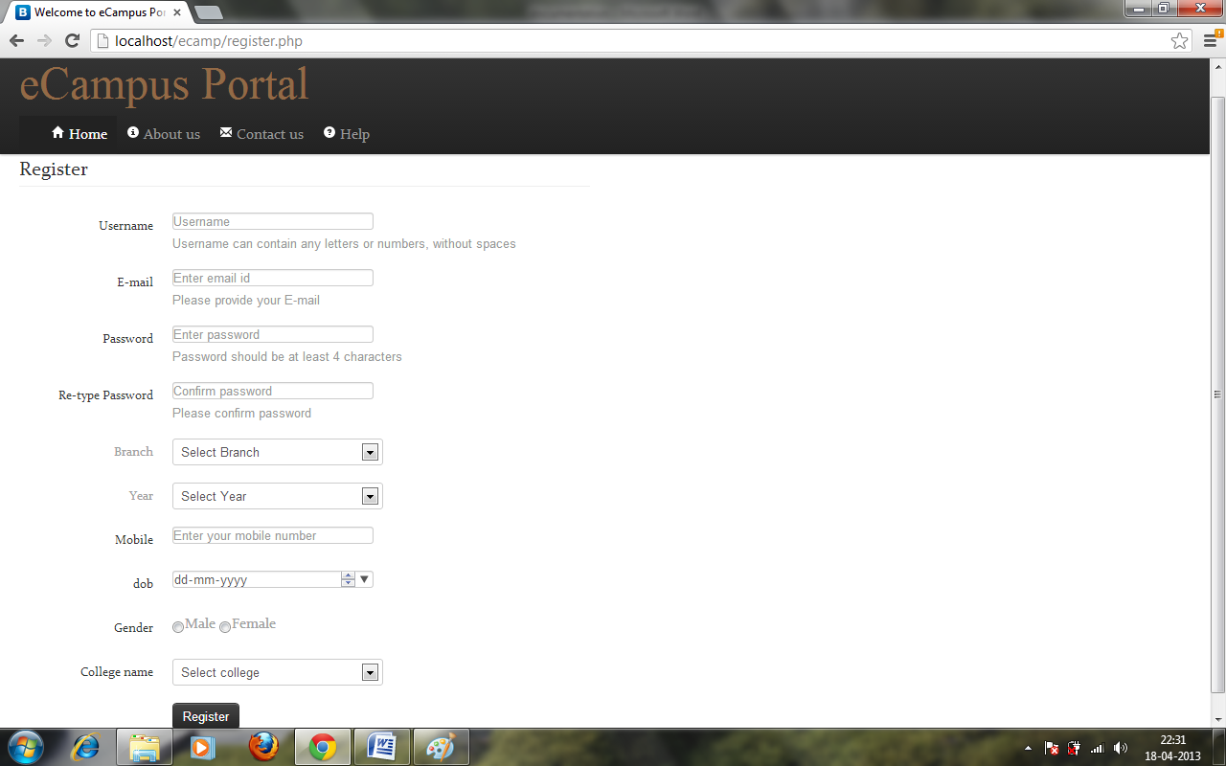
Student Registration

Slide 19
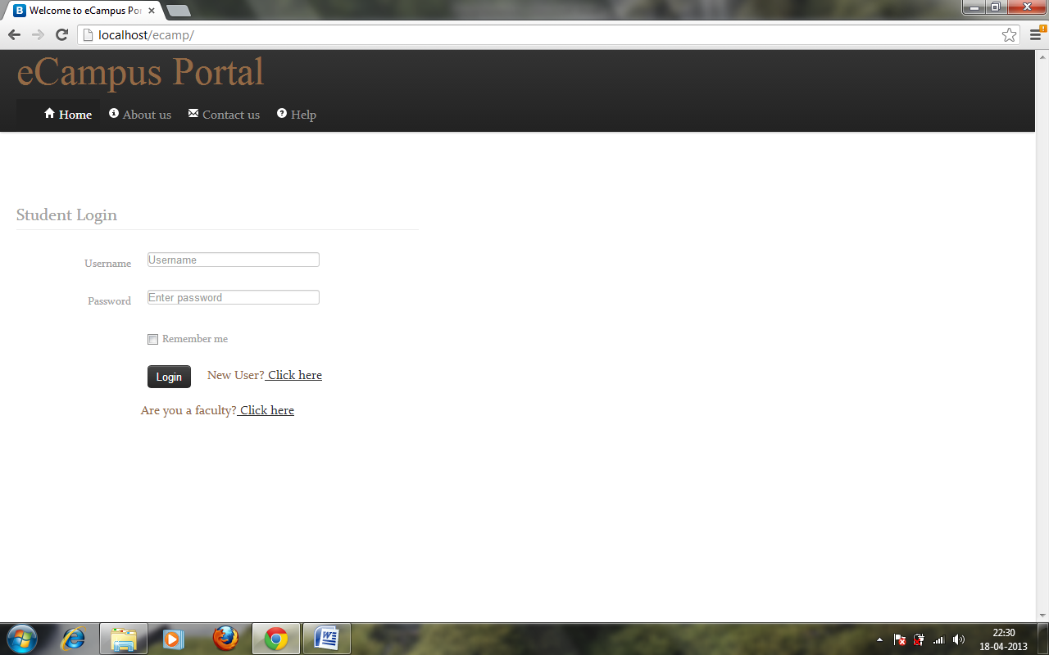
Student Login

Slide 20
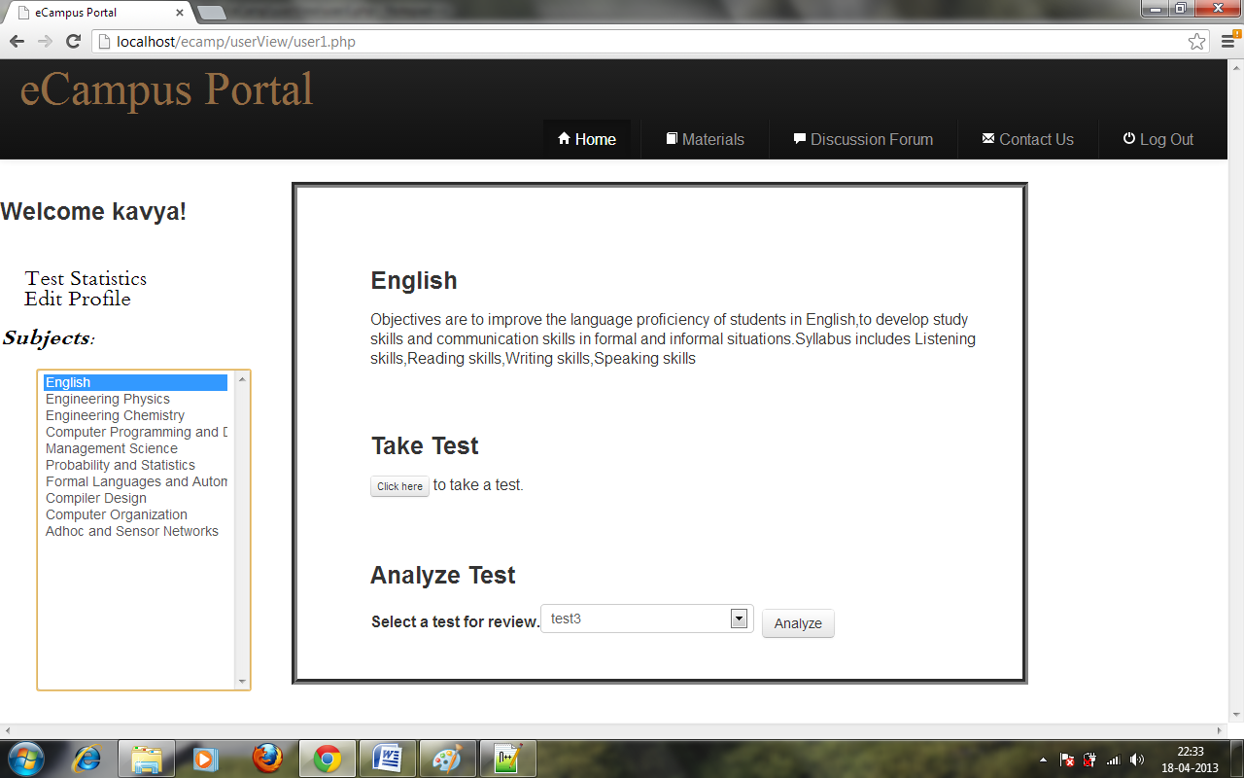
Student home page

Slide 21
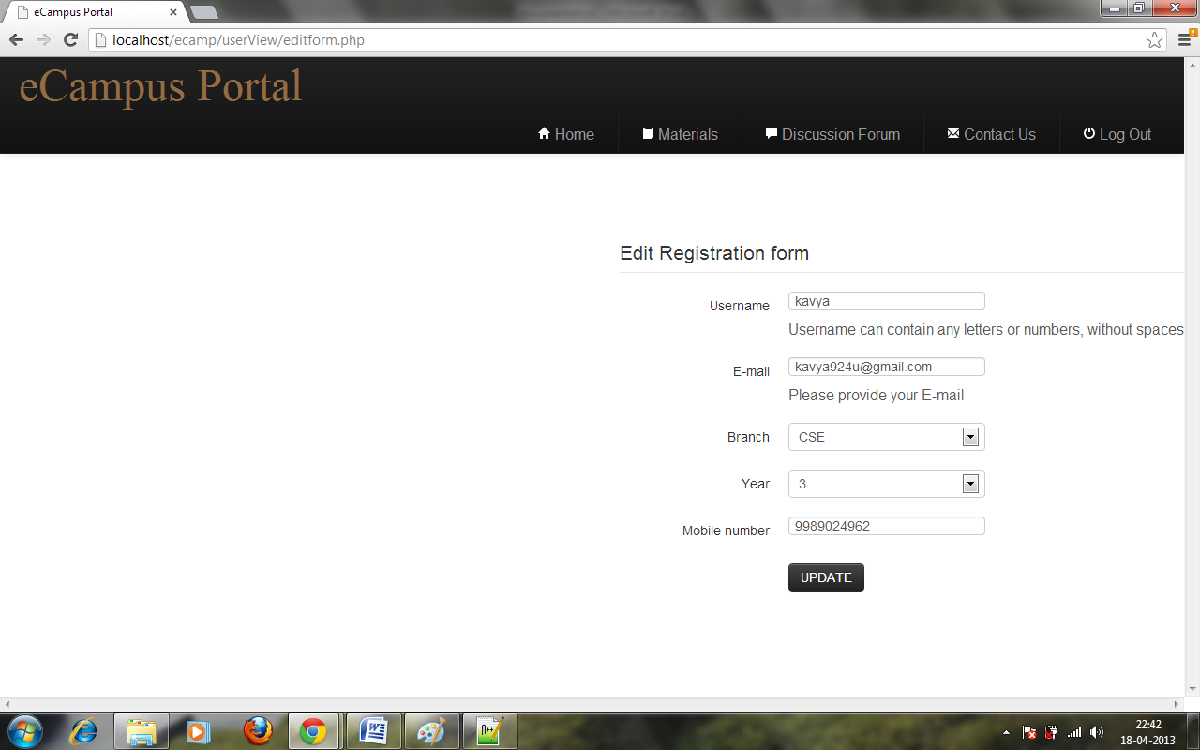
Student edit profile

Slide 22
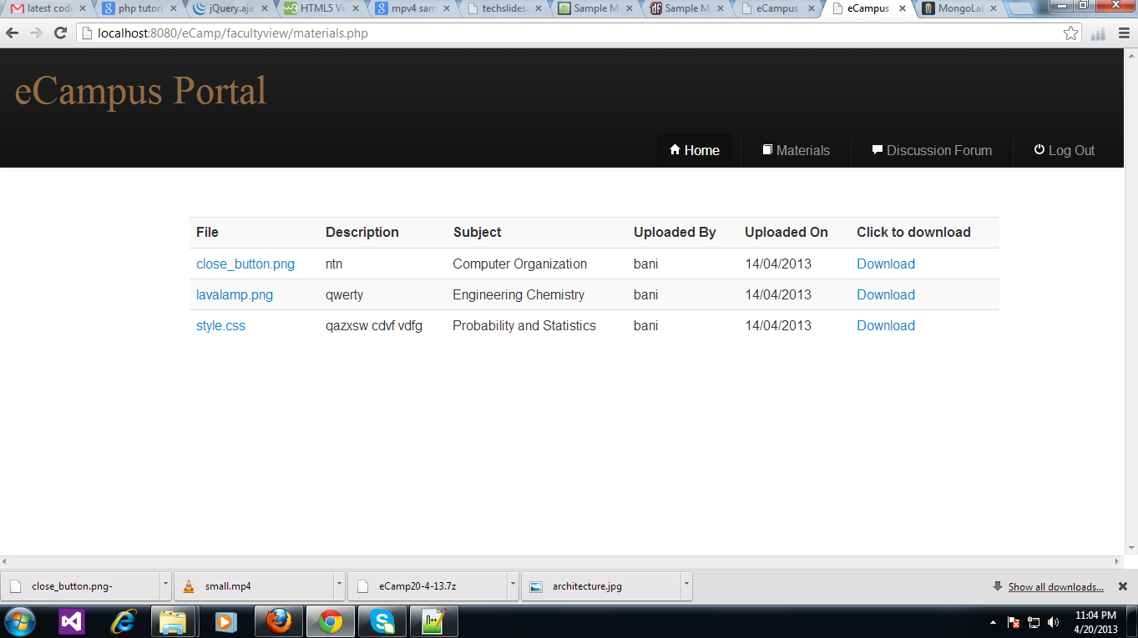
Materials Page

Slide 23
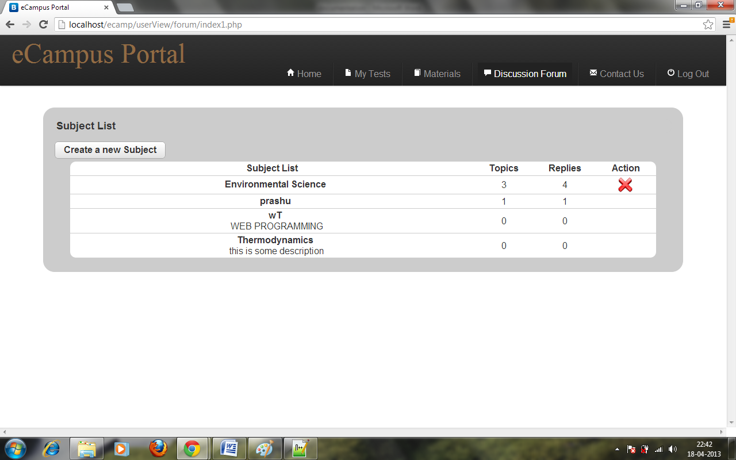
Discussion forum main page

Slide 24
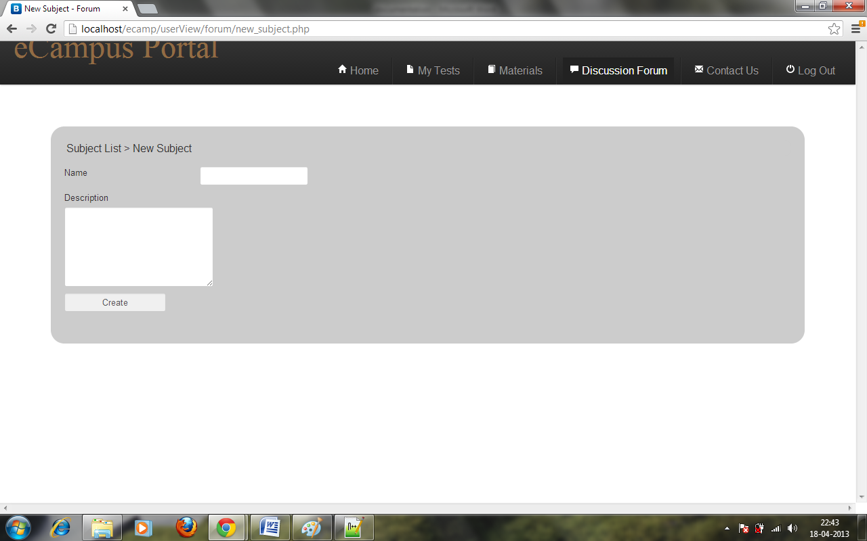
Create new subject

Slide 25
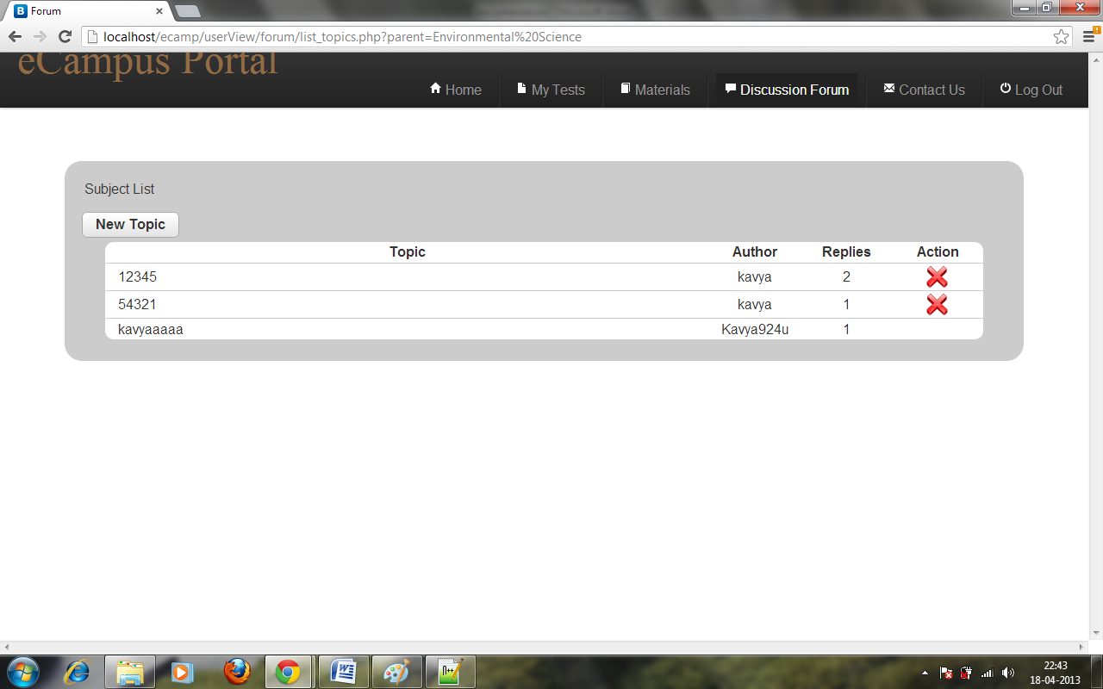
Topics list in a subject

Slide 26
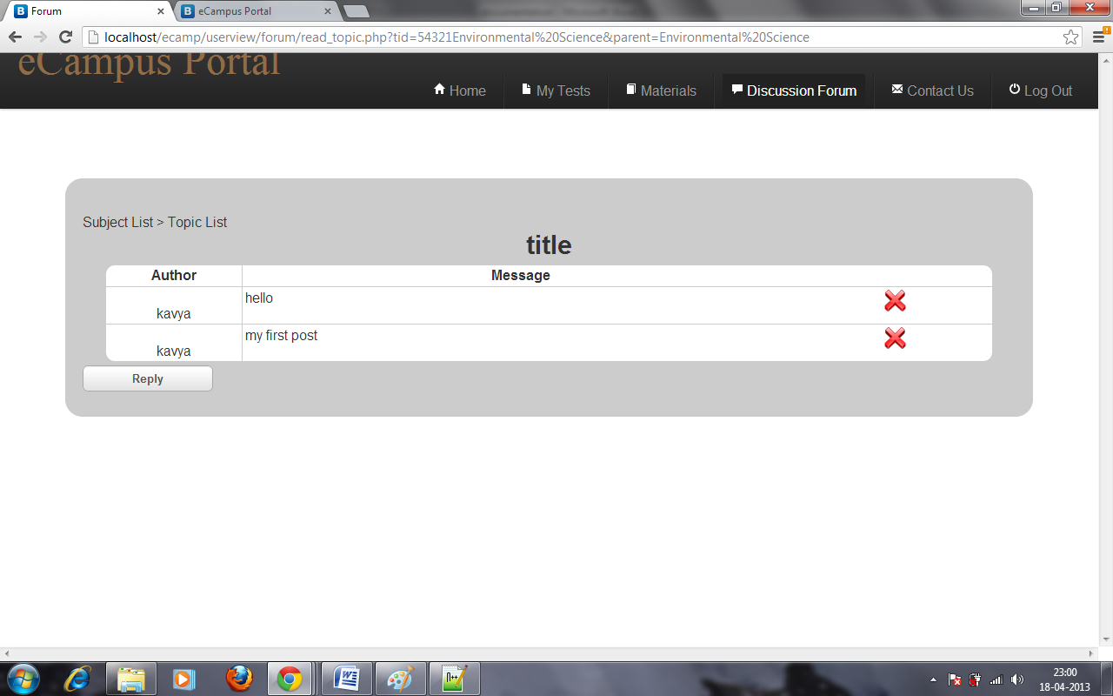
Comments in a discussion

Slide 27
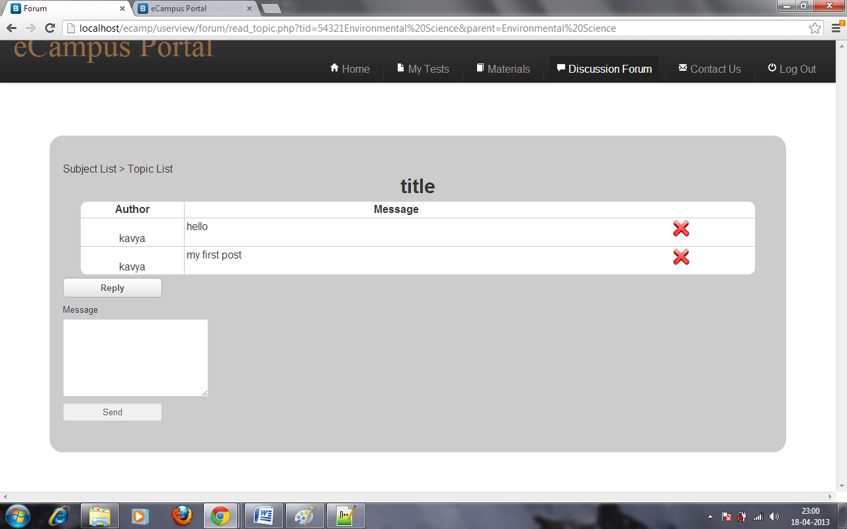
Add comments

Slide 28
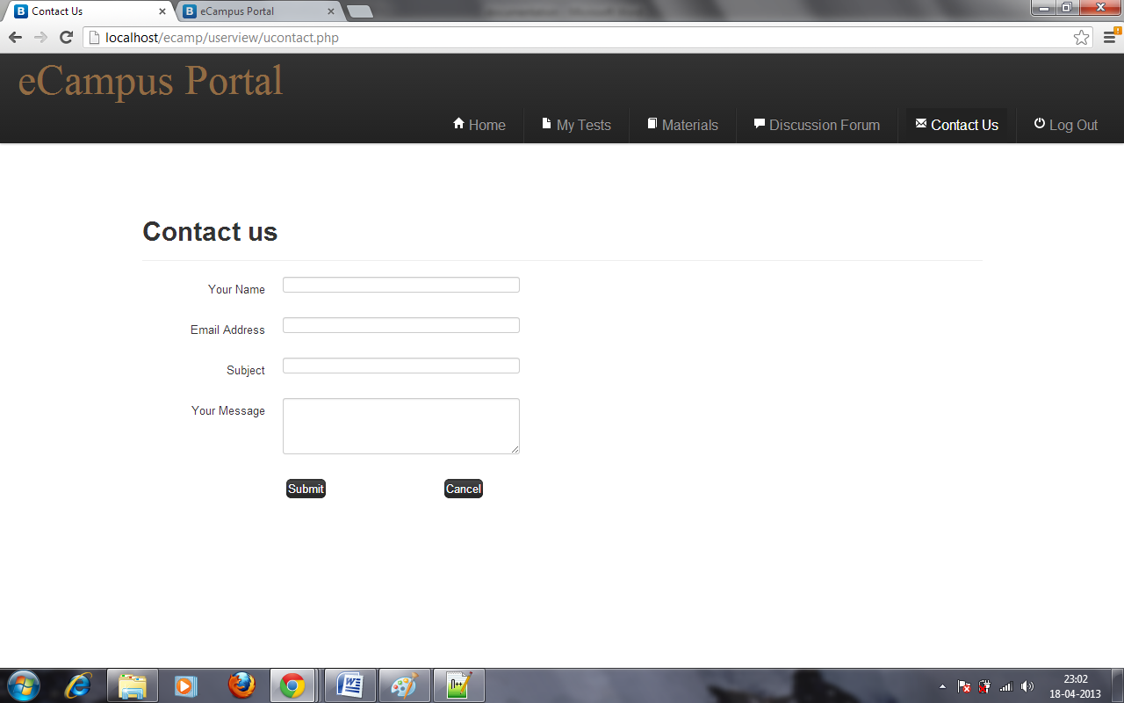
Student contact form

Slide 29
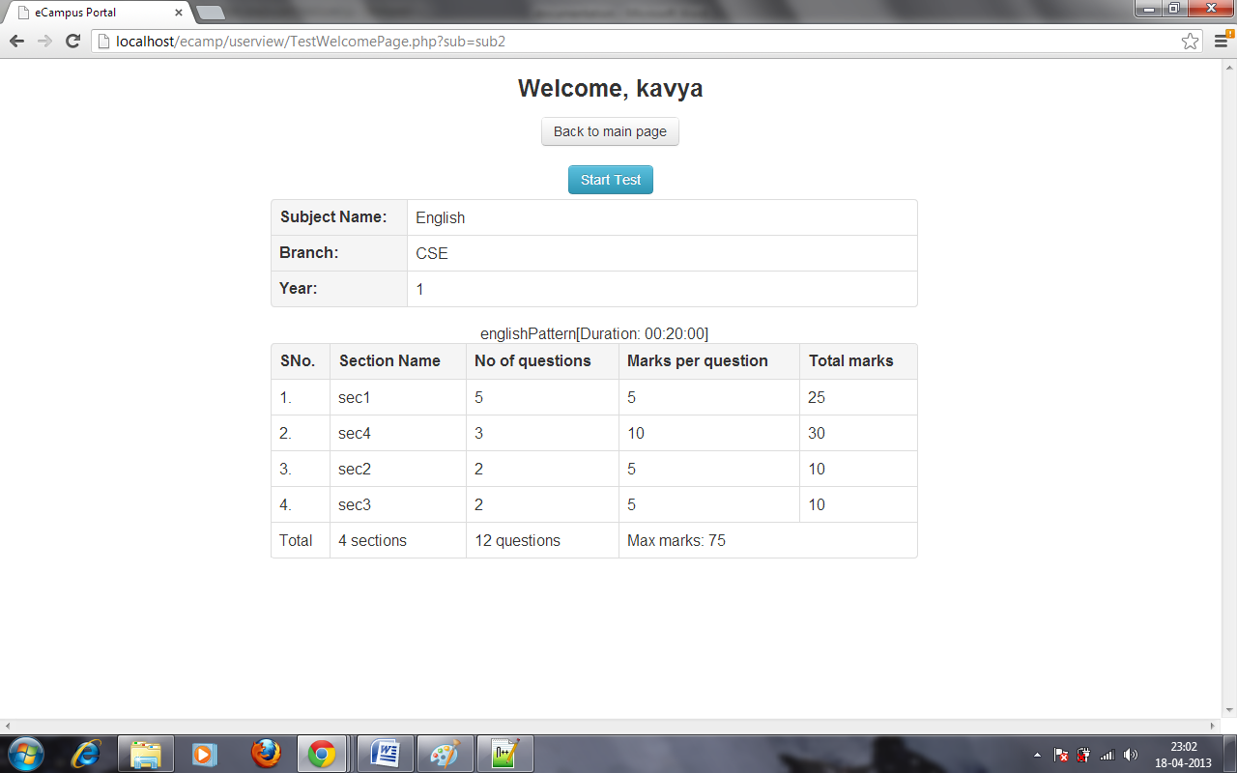
Test Welcome Page

Slide 30
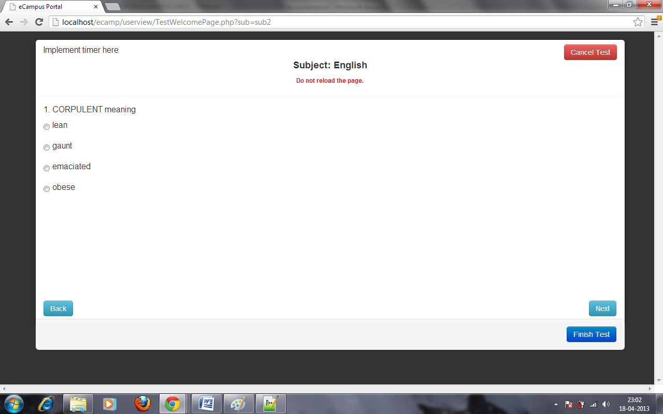
Test Page

Slide 31
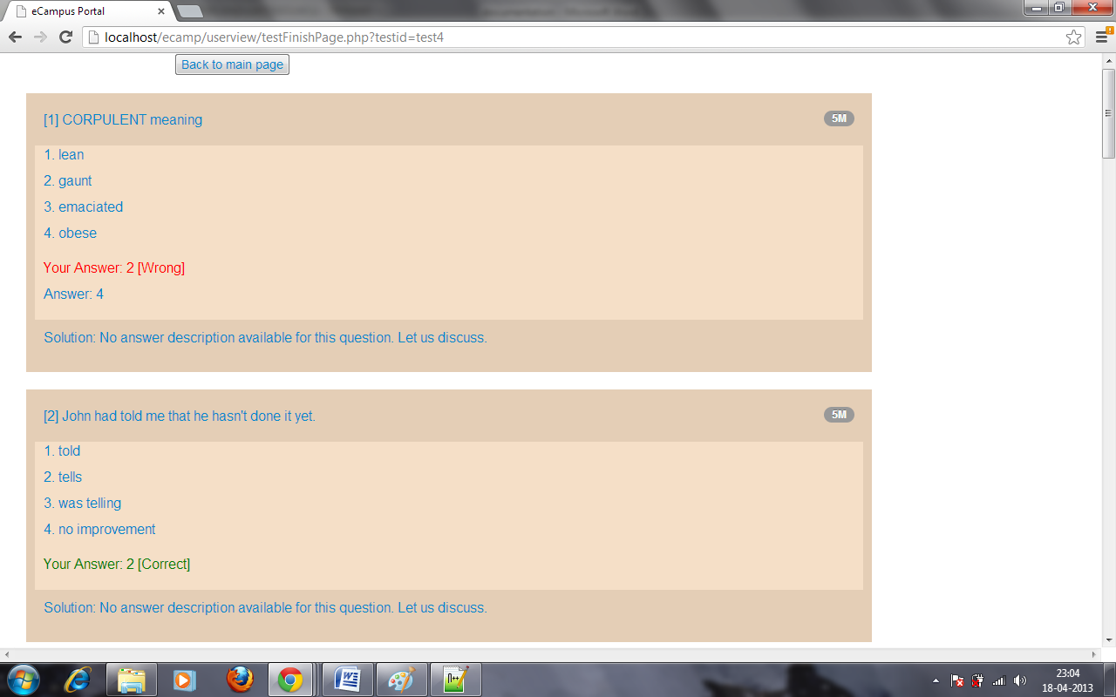
Test Results

Slide 32
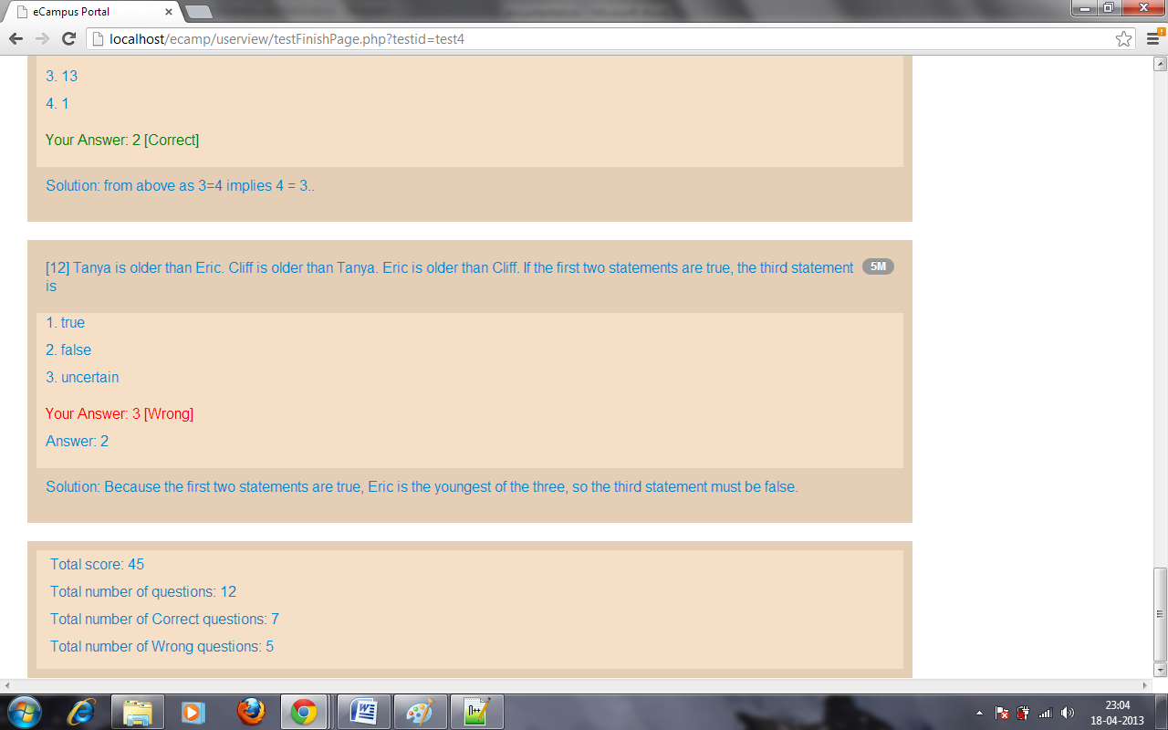
Test Results

Slide 33
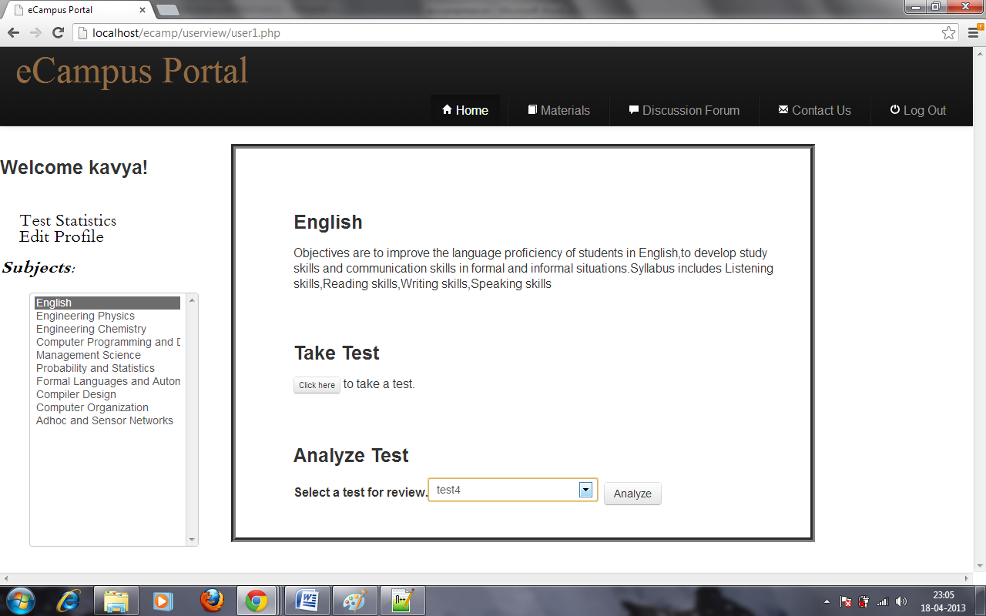
Analyze Test

Slide 34
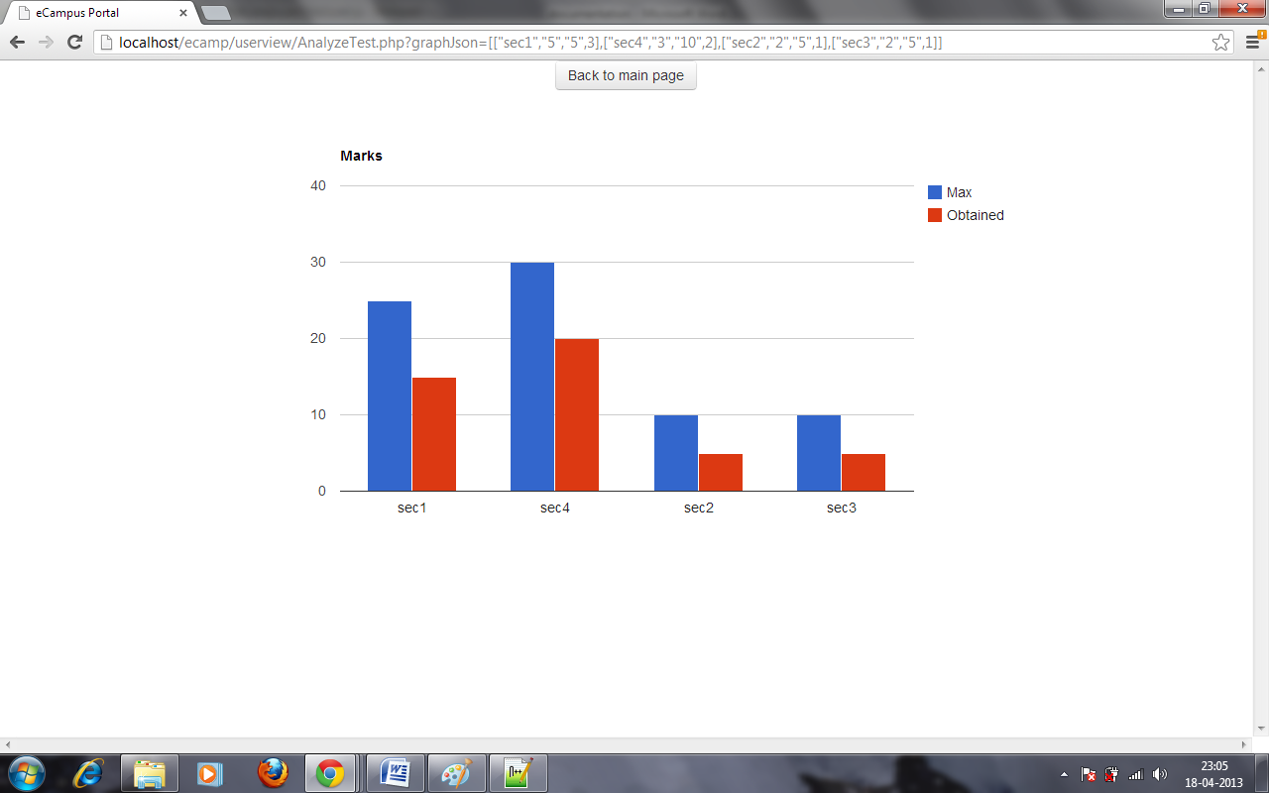
Test Analysis

Slide 35
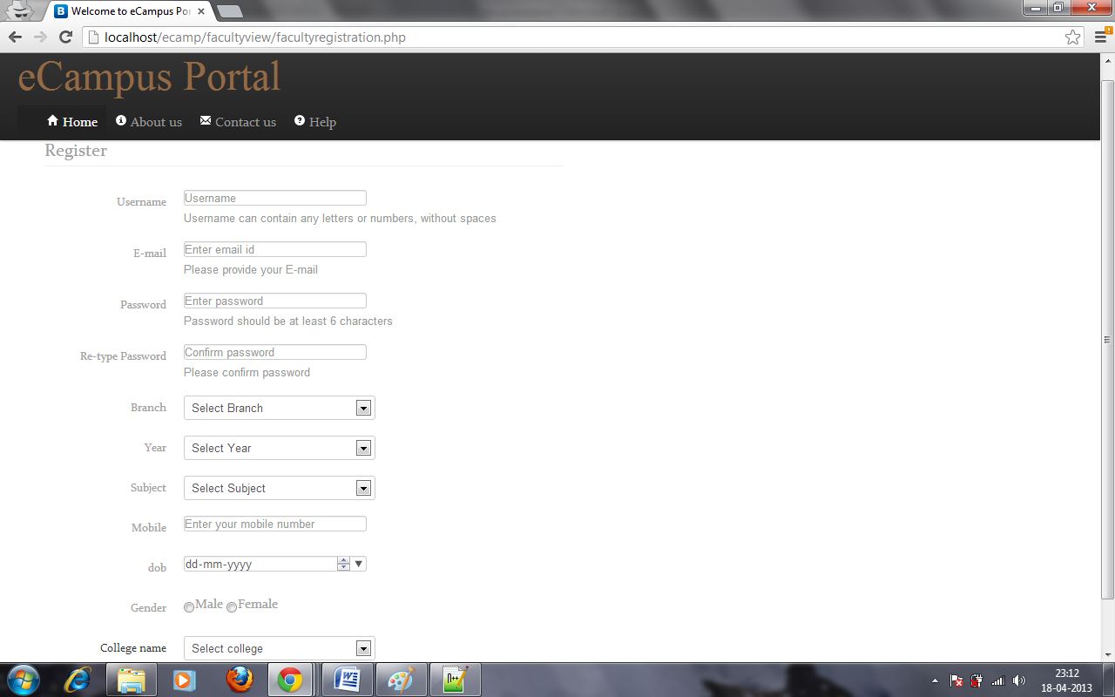
Faculty Registration

Slide 36
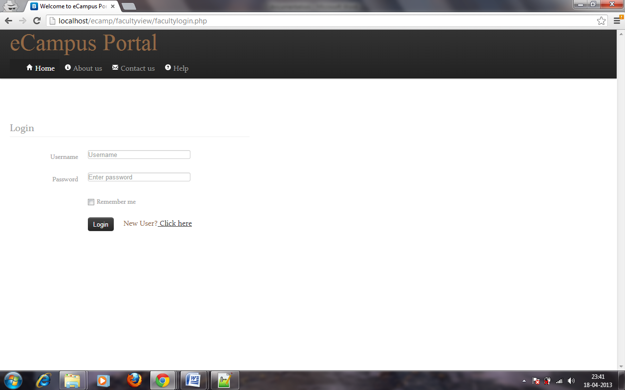
Faculty Login

Slide 37
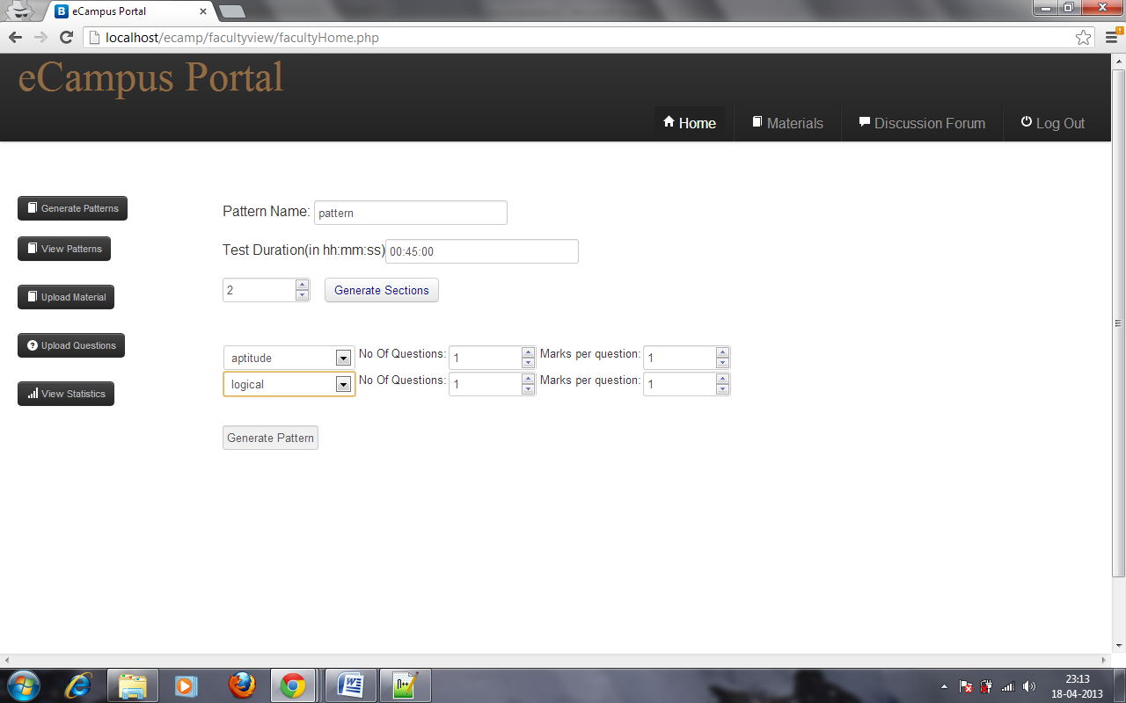
Pattern generation

Slide 38
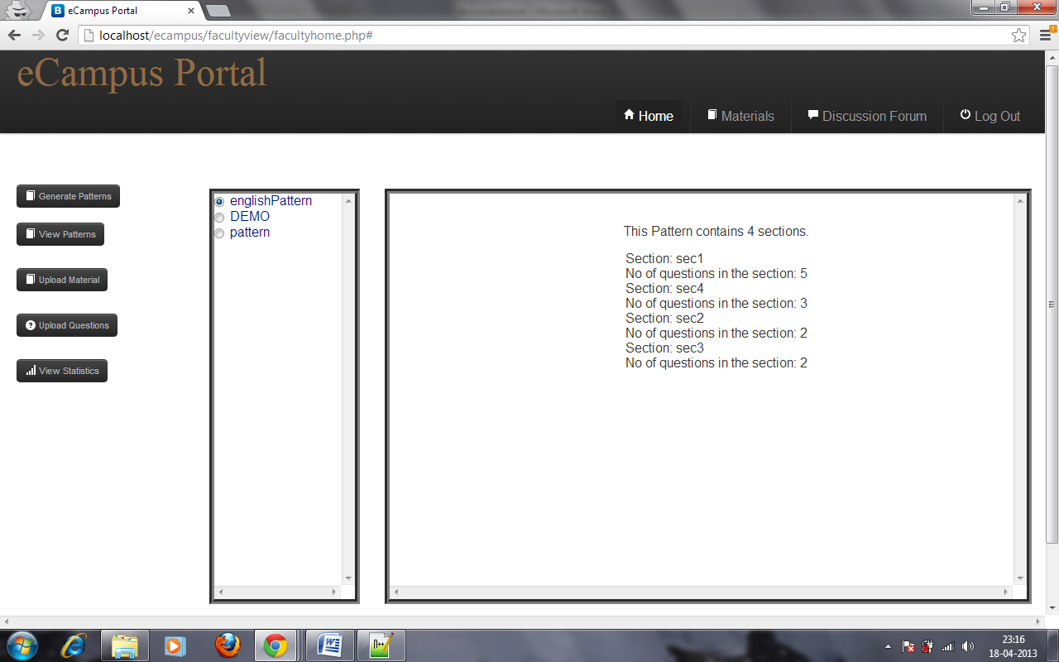
View Pattern

Slide 39
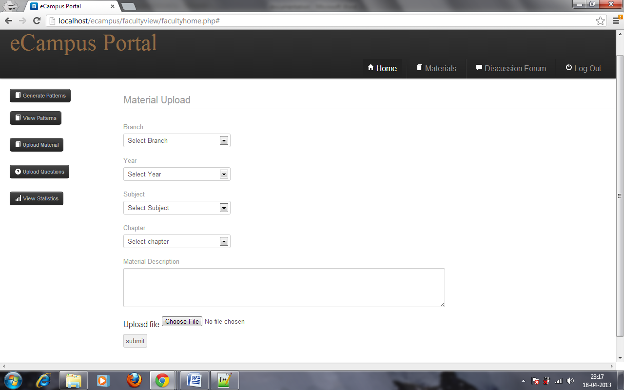
Upload material

Slide 40
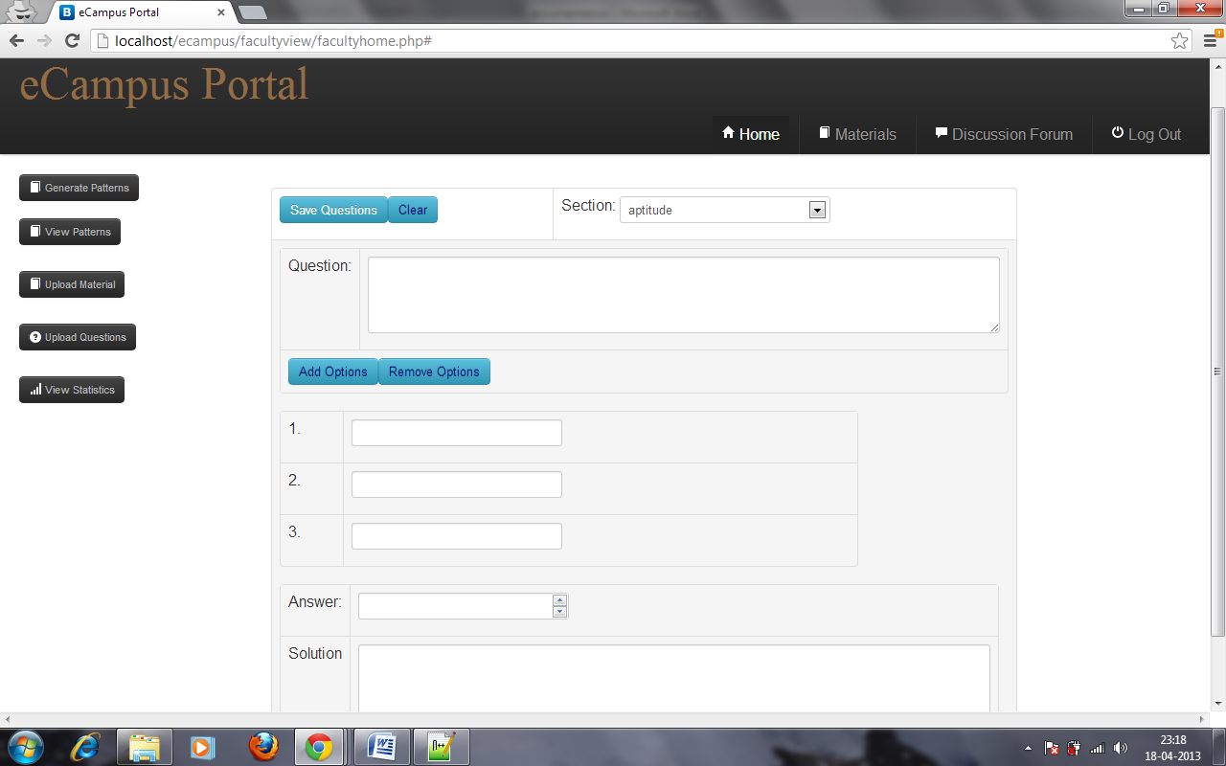
Upload Question

Slide 41
Material Page

Slide 42
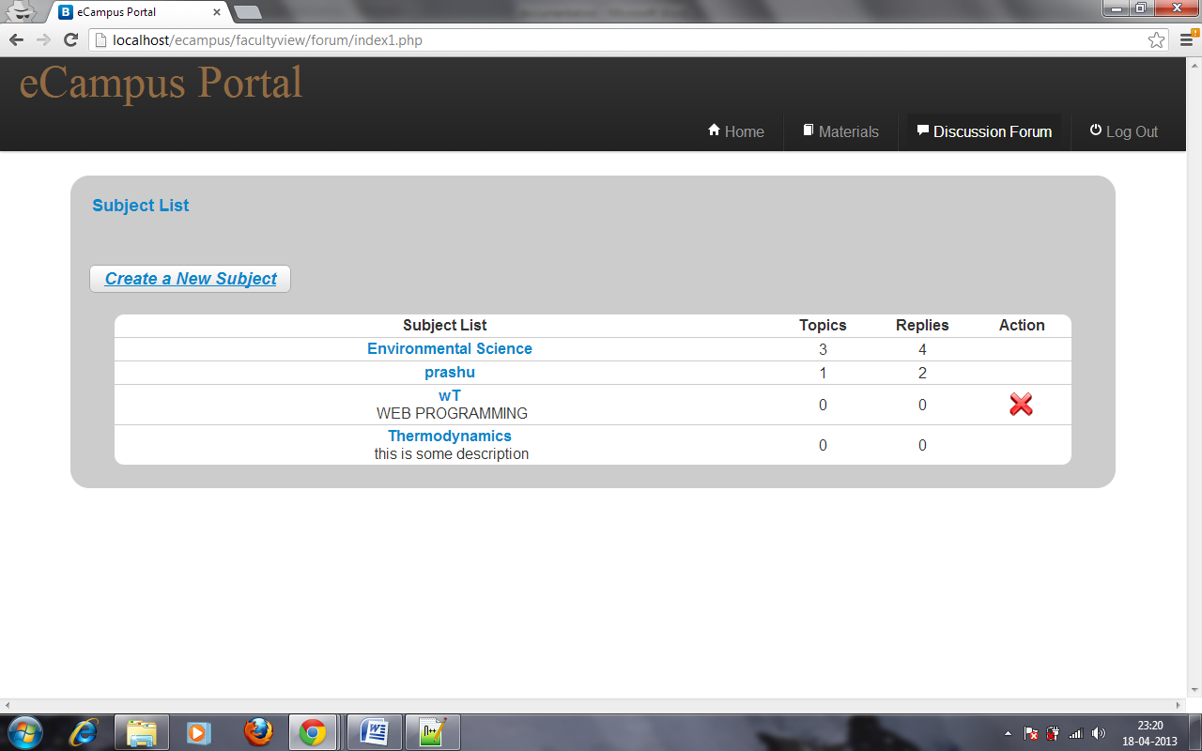
Discussion forum subject list

Slide 43
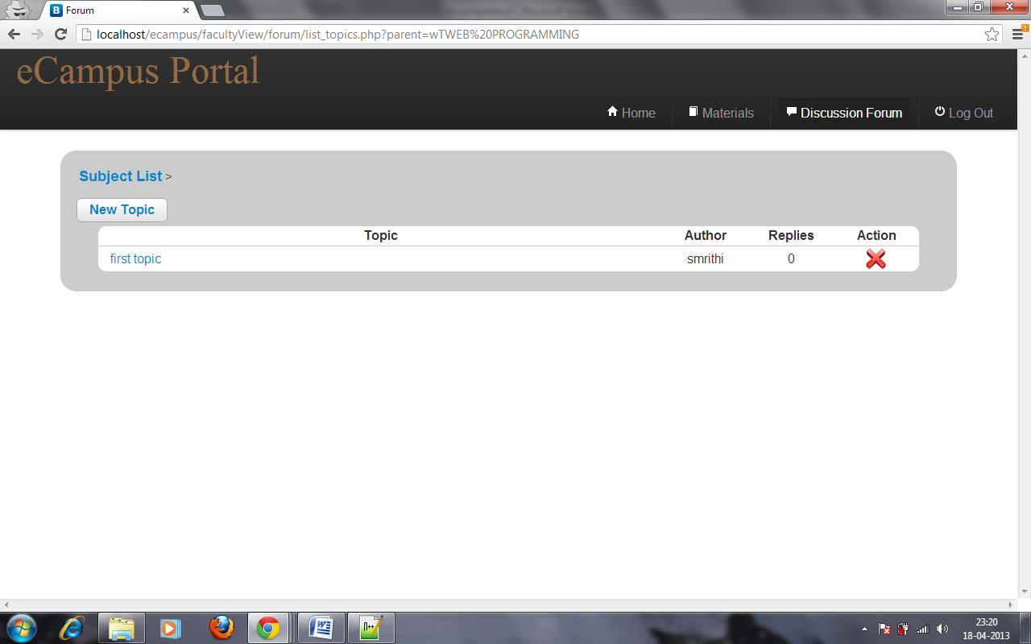
Topic List

Slide 44
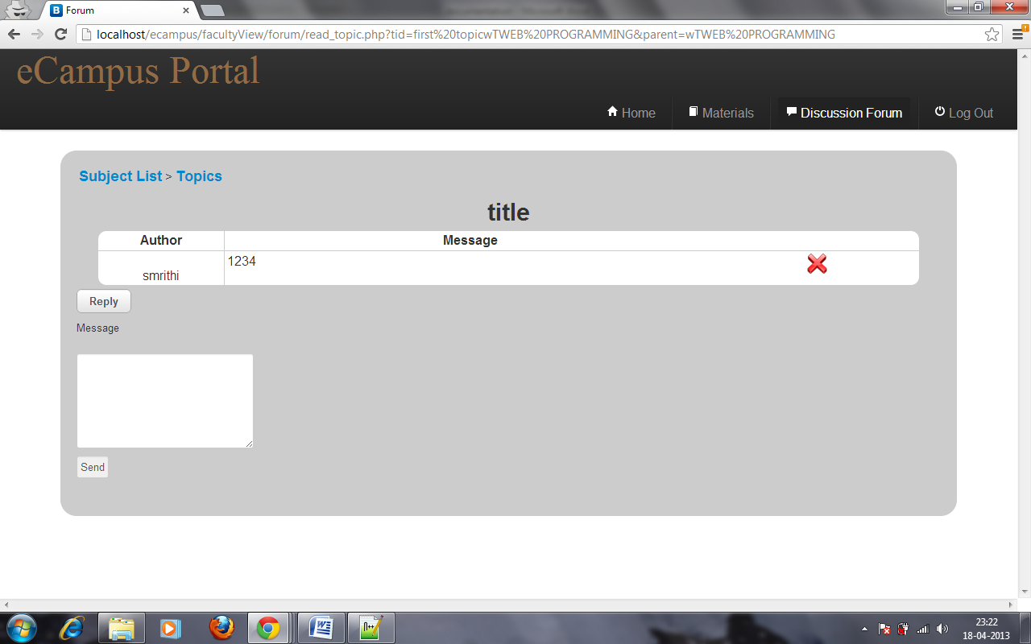
Post comments in a forum

Slide 45

Performance Issue/Results

Slide 46

Conclusion
This application helps student to interact with their faculty outside the classroom.
The students can analyze themselves by taking the customized tests set by faculty and even utilize the materials shared by them.
Thus helping students both academically and non-academically.

Slide 47

References
PHP MANUAL : http://www.php.net/manual/en/index.php
MONGO DOCS : http://docs.mongodb.org/manual/
BOOTSTRAP : http://twitter.github.com/bootstrap/

Slide 48

Q & A
Any Queries?

Slide 49


